Slide 1
Data Engineering
Abdul Rasheed Feroz Khan
Microsoft MVP – Azure
Microsoft Certified Trainer

Slide 2
Session Objective and Key Takeaway
Explore the power of Azure to perform multiple database transactions at once by using the Massively Parallel Processing facility of Azure SQL Datawarehouse and leverage the process of migration of data into Azure SQL Datawarehouse using Azure Data Factory.

Slide 3
Parallel Processing and Pipelining in Azure
This session will be a deep dive into the core part of Azure Data Factory and Azure SQL Datawarehouse and how the users can get benefited with the integration of Azure SQL Datawarehouse with Azure Data Factory for configuring data pipeline to move data with ease.

Slide 4
Data Warehouse in Azure

Slide 5
Azure SQL Data Warehouse
SQL Data Warehouse is a cloud-based Enterprise Data Warehouse
Leverages Massively Parallel Processing (MPP) to quickly run complex queries across petabytes of data
SQL Data Warehouse is a key component of a big data solution
Big data can be imported into SQL Data Warehouse with simple PolyBase T-SQL queries to run high-performance analytics

Slide 6
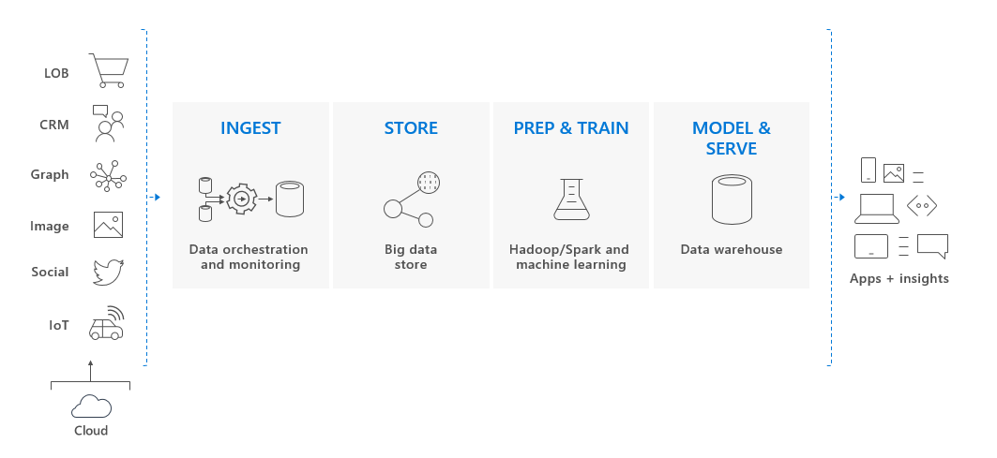
Key component of big data solution

Slide 7
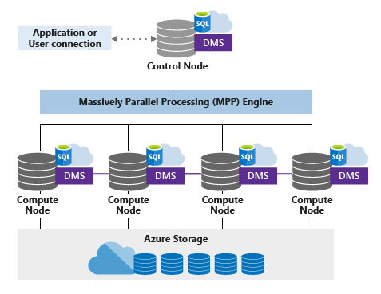
Azure SQL Data Warehouse Architecture

Slide 8
MPP architecture components
SQL Data Warehouse leverages a scale out architecture to distribute computational processing of data across multiple nodes
The unit of scale is an abstraction of compute power that is known as a data warehouse unit
SQL Data Warehouse separates compute from storage which enables to scale compute independently of the data

Slide 9
Benefits of decoupled storage
Independently size compute power irrespective of your storage needs
Grow or shrink compute power without moving data
Pause compute capacity while leaving data intact, so you only pay for storage
Resume compute capacity during operational hours

Slide 10
Azure Storage
SQL Data Warehouse uses Azure storage to keep data safe
The data itself is sharded into distributions to optimize the performance
Sharding pattern can be chosen to distribute the data when defining the table
SQL Data Warehouse supports these sharding patterns:
Hash
Round Robin
Replicate

Slide 11
Control node
Control node is the brain of the data warehouse
It is the front end that interacts with all applications and connections
The MPP engine runs on the Control node to optimize and coordinate parallel queries
When T-SQL queries are submitted to SQL Data Warehouse, the Control node transforms it into queries that run against each distribution in parallel

Slide 12
Compute nodes
The Compute nodes provide the computational power
Distributions map to Compute nodes for processing
As you pay for more compute resources, SQL Data Warehouse re-maps the distributions to the available Compute nodes
The number of compute nodes ranges from 1 to 60, and is determined by the service level for the data warehouse
Each Compute node has a node ID that is visible in system views

Slide 13
Data Movement Service
Data Movement Service (DMS) is the data transport technology that coordinates data movement between the Compute nodes
Some queries require data movement to ensure the parallel queries return accurate results
When data movement is required, DMS ensures the right data gets to the right location

Slide 14
Distributions
A distribution is the basic unit of storage and processing for parallel queries that run on distributed data
When SQL Data Warehouse runs a query, the work is divided into 60 smaller queries that run in parallel
Each of the 60 smaller queries runs on one of the data distributions
Each Compute node manages one or more of the 60 distributions

Slide 15
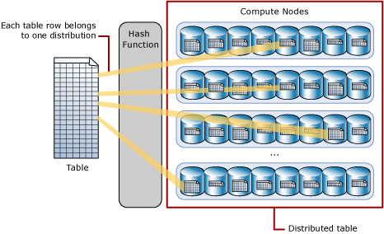
Hash-distributed tables
Hash distributed table can deliver the highest query performance for joins and aggregations on large tables

Slide 16
Round-robin distributed tables
A round-robin table is the simplest table to create and delivers fast performance when used as a staging table for loads
Distributes data evenly across the table but without any further optimization
A distribution is first chosen at random and then buffers of rows are assigned to distributions sequentially

Slide 17
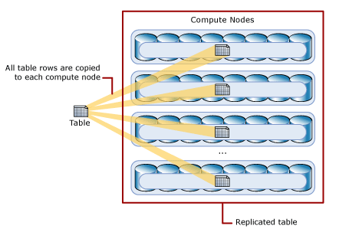
Replicated Tables
A replicated table provides the fastest query performance for small tables
A table that is replicated caches a full copy of the table on each compute node

Slide 18
Data Warehouse Units
SQL Data Warehouse CPU, memory, and IO are bundled into units of compute scale called Data Warehouse Units (DWUs)
A DWU represents an abstract, normalized measure of compute resources and performance
Altering the number of DWUs that are allocated to the system, which in turn adjusts the performance, and the cost, of the system

Slide 19
Effects of increasing Data Warehouse Units
Linearly changes performance of the system for scans, aggregations, and CTAS statements
Increases the number of readers and writers for PolyBase load operations
Increases the maximum number of concurrent queries and concurrency slots.

Slide 20
Service Level Objective
Service Level Objective (SLO) is the scalability setting that determines the cost and performance level of data warehouse
The service levels for Gen2 are measured in compute data warehouse units
For example DW2000c
Gen1 service levels are measured in DWUs
For example DW2000

Slide 21
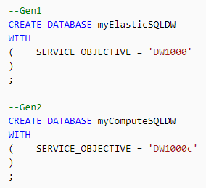
Configuring Service Level Objective using T-SQL
In T-SQL the SERVICE_OBJECTIVE setting determines the service level and the performance tier for data warehouse

Slide 22
Performance Tiers and Data Warehouse Units
Each performance tier uses a slightly different unit of measure for their data warehouse units
This difference is reflected on the invoice as the unit of scale
Gen1 data warehouses are measured in Data Warehouse Units (DWUs)
Gen2 data warehouses are measured in compute Data Warehouse Units (cDWUs)

Slide 23
Capacity Limits
SQL server has a Database Transaction Unit quota that allows a specific number of DWUs
 | Basic | Standard | Premium
Target workload | Development and production | Development and production | Development and production
Uptime SLA | 99.99% | 99.99% | 99.99%
Backup retention | 7 days | 35 days | 35 days
CPU | Low | Low, Medium, High | Medium, High
IO throughput (approximate) | 2.5 IOPS per DTU | 2.5 IOPS per DTU | 48 IOPS per DTU
IO latency (approximate) | 5 ms (read), 10 ms (write) | 5 ms (read), 10 ms (write) | 2 ms (read/write)
Columnstore indexing | N/A | S3 and above | Supported
In-memory OLTP | N/A | N/A | Supported

Slide 24
Steps for finding the best DWU for a workload
Begin by selecting a smaller DWU
Monitor application performance as you test data loads into the system, observing the number of DWUs selected compared to the performance
Identify any additional requirements for periodic periods of peak activity.
If the workload shows significant peaks and troughs in activity and there is a good reason to scale frequently

Slide 25
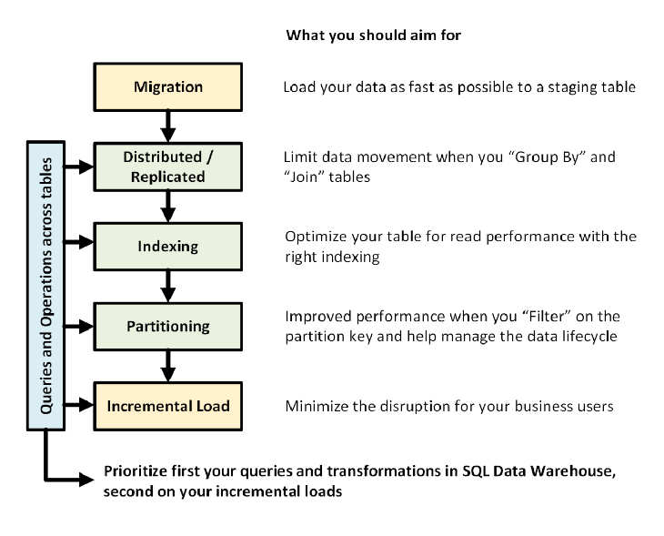
Designing a Data Warehouse

Slide 26
Compute Management
The architecture of SQL Data Warehouse separates storage and compute, allowing each to scale independently
As a result, you can scale compute to meet performance demands independent of data storage
You can also pause and resume compute resources
If you don't need to use your data warehouse for a while, you can save compute costs by pausing compute

Slide 27
Data Warehouse distributions per node
Data warehouse units​ | # of Compute nodes​ | # of distributions per node​
100​ | 1​ | 60​
200​ | 2​ | 30​
300​ | 3​ | 20​
400​ | 4​ | 15​
500​ | 5​ | 12​
600​ | 6​ | 10​
1000​ | 10​ | 6​
1200​ | 12​ | 5​
1500​ | 15​ | 4​
2000​ | 20​ | 3​
3000​ | 30​ | 2​
6000​ | 60​ | 1​

Slide 28
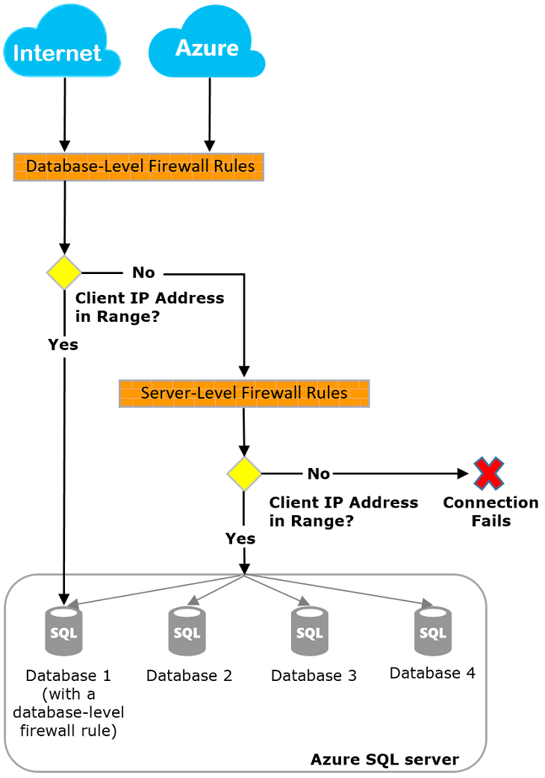
Data Warehouse firewall

Slide 29
Tools to query with SQL Data Warehouse
Microsoft Visual Studio
SQL Server Management Studio

Slide 30
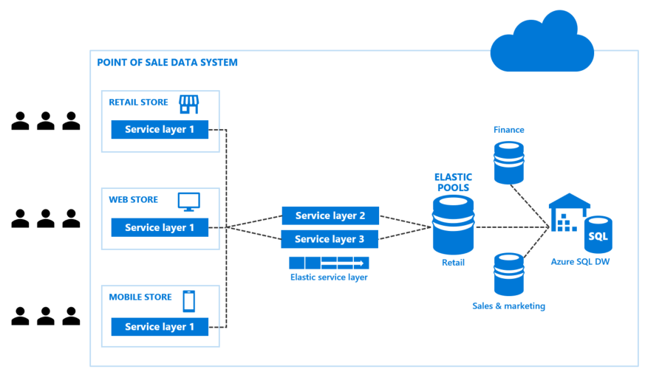
SQL Data Warehouse scenario

Slide 31
Demo
Deploying Azure SQL Data Warehouse

Slide 32
Azure Data Factory

Slide 33
Azure Data Factory
A cloud-based data integration service
Allows to create data-driven workflows in the cloud that orchestrate and automate data movement and data transformation

Slide 34
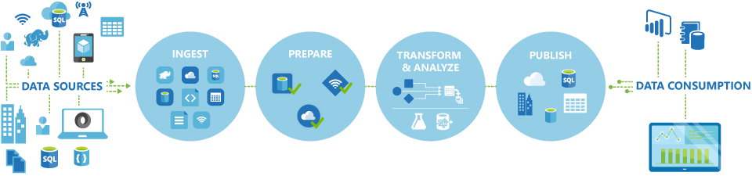
Azure Data Factory workflow

Slide 35
What does Azure Data Factory do?
Create and schedule data-driven workflows that can ingest data from disparate data stores
Process or transform the data by using compute services such as Azure HDInsight Hadoop, Spark, Azure Data Lake Analytics, and Azure Machine Learning
Publish output data to data stores such as Azure SQL Data Warehouse for business intelligence (BI) applications to consume

Slide 36
How does it work?
The pipelines in Azure Data Factory typically perform the following three steps

Slide 37
Connect and collect
Enterprises have data of various types that are located in disparate sources
The first step in building an information production system is to connect to all the required sources of data and processing
With Data Factory, you can use the Copy Activity in a data pipeline to move data from both on-premises and cloud source data stores

Slide 38
Transform and enrich
After data is present in a centralized data store in the cloud, it mus br processed or transferred by using compute services
The transformation services can be HDInsight Hadoop, Spark, Data Lake Analytics, or Machine Learning

Slide 39
Publish
Transformed data is delivered from the cloud to on-premises sources such as SQL Server
Alternatively, it can be kept in cloud storage sources for consumption by BI and analytics tools and other applications

Slide 40
Key components
Pipeline
Activity
Data movement activities
Data transformation activities
Datasets
Linked services

Slide 41
Pipeline
A data factory can have one or more pipelines
A pipeline is a group of activities
Together, the activities in a pipeline perform a task
For example, a pipeline can contain a group of activities that ingests data from an Azure blob, and then runs a Hive query on an HDInsight cluster to partition the data

Slide 42
Activity
A pipeline can have one or more activities
Activities define the actions to perform on data
For example, you can use a copy activity to copy data from one data store to another data store

Slide 43
Data movement activities
Copy Activity in Data Factory copies data from a source data store to a sink data store
Data from any source can be written to any sink

Slide 44
Data transformation activities
Data transformation activity | Compute environment
Hive | HDInsight [Hadoop]
Pig | HDInsight [Hadoop]
MapReduce | HDInsight [Hadoop]
Hadoop Streaming | HDInsight [Hadoop]
Spark | HDInsight [Hadoop]
Machine Learning activities: Batch Execution and Update Resource | Azure VM
Stored Procedure | Azure SQL, Azure SQL Data Warehouse, or SQL Server
Data Lake Analytics U-SQL | Azure Data Lake Analytics
DotNet | HDInsight [Hadoop] or Azure Batch

Slide 45
Datasets
An activity takes zero or more datasets as inputs and one or more datasets as outputs
Datasets represent data structures within the data stores
For example, an Azure blob dataset specifies the blob container and folder in the Azure blob storage from which the pipeline should read the data

Slide 46
Linked services
Linked services are much like connection strings
They define the connection information that's needed for Data Factory to connect to external resources
For example, an Azure Storage-linked service specifies a connection string with which to connect to the Azure Storage account

Slide 47
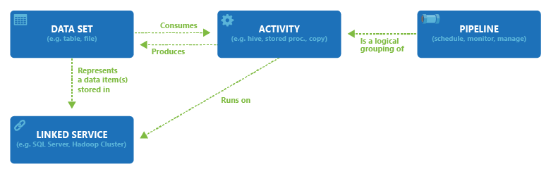
Relationship between Data Factory entities

Slide 48
Working with a pipeline
You can use one of these tools or APIs to create data pipelines in Azure Data Factory:
Azure portal
Visual Studio
PowerShell
.NET API
REST API
Azure Resource Manager template

Slide 49

Azure Data Factory Pipeline and Activity

Slide 50
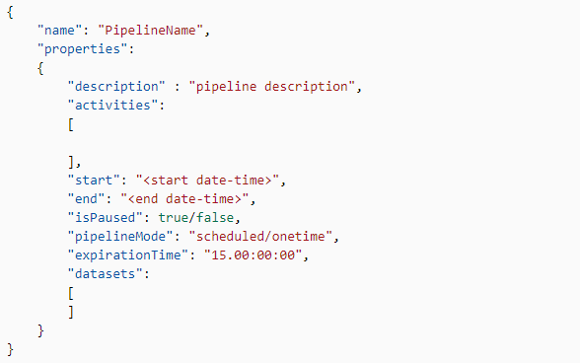
Defining a Pipeline in JSON

Slide 51
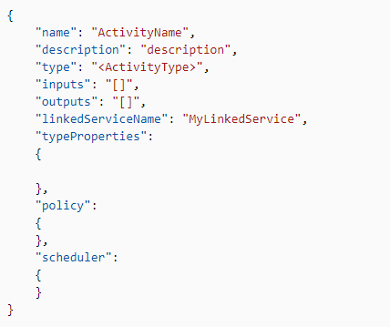
Defining a Activity in JSON

Slide 52
Datasets in Azure Data Factory
An activity can take zero or more input datasets, and produce one or more output datasets
An input dataset represents the input for an activity in the pipeline
An output dataset represents the output for the activity
Datasets identify data within different data stores, such as tables, files, folders, and documents

Slide 53
Pipeline, Activity, Dataset, and Linked service

Slide 54
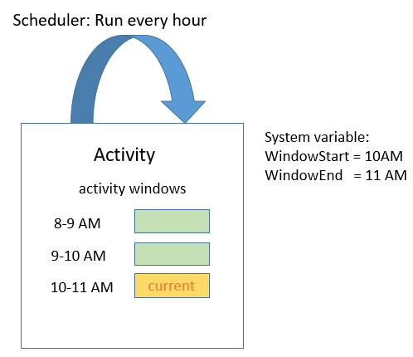
Schedules in Azure Data Factory
A pipeline is active only between its start time and end time
It is not executed before the start time or after the end time
The scheduler propery can be used for automating the pieplines

Slide 55
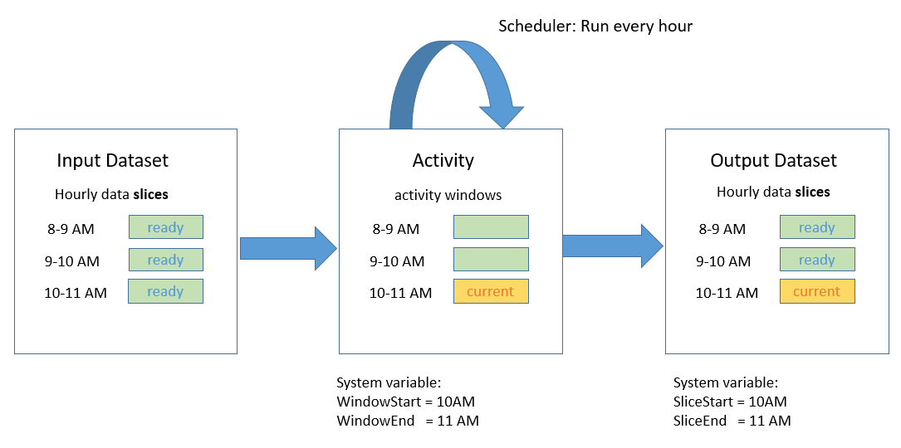
Data slice in Azure Data Factory
Each unit of data consumed or produced by an activity run is called a data slice

Slide 56
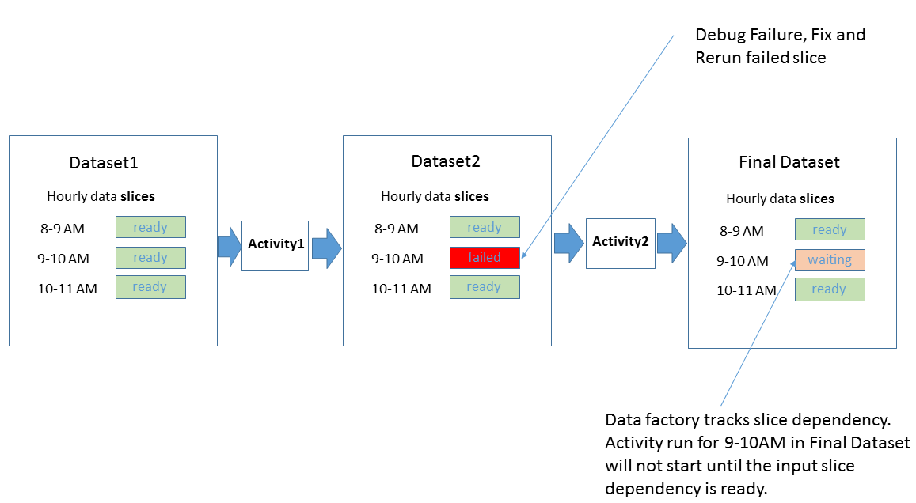
Rerunning a failed data slice
When an error occurs while processing a data slice, you can find out why the processing of a slice failed by using Azure portal blades

Slide 57
Demo
Deploying Azure Data Factory

Slide 58
Polybase
PolyBase enables your SQL Server to process Transact-SQL queries that read data from Hadoop
The same query can also access relational tables in your SQL Server
PolyBase enables the same query to also join the data from Hadoop and SQL Server

Slide 59
Supported SQL products and services
PolyBase provides these same functionalities for the following SQL products from Microsoft:
SQL Server 2016 and later versions (Windows only)
Analytics Platform System (formerly Parallel Data Warehouse)
Azure SQL Data Warehouse

Slide 60
Azure integration
With the underlying help of PolyBase, T-SQL queries can also import and export data from Azure Blob Storage
PolyBase enables Azure SQL Data Warehouse to import and export data from Azure Data Lake Store, and from Azure Blob Storage

Slide 61
Why to use PolyBase
In the past it was more difficult to join your SQL Server data with external data
There were two unpleasent options:
Transfer half data so that all your data was in one format or the other
Query both sources of data, then write custom query logic to join and integrate the data at the client level
PolyBase avoids those unpleasant options by using T-SQL to join the data

Slide 62
PolyBase uses
Query data stored in Hadoop from SQL Server or PDW
Query data stored in Azure Blob Storage
Import data from Hadoop, Azure Blob Storage, or Azure Data Lake Store
Export data to Hadoop, Azure Blob Storage, or Azure Data Lake Store
Integrate with BI tools

Slide 63
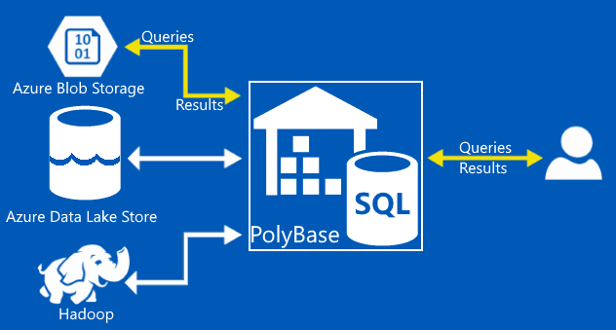
Using Data Factory and Polybase in data pipelines

Slide 64
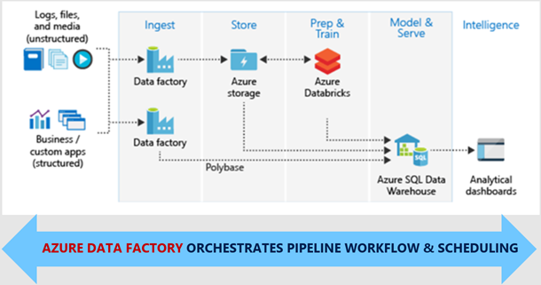
Azure Data Factory with SQL Data Warehouse

Slide 65
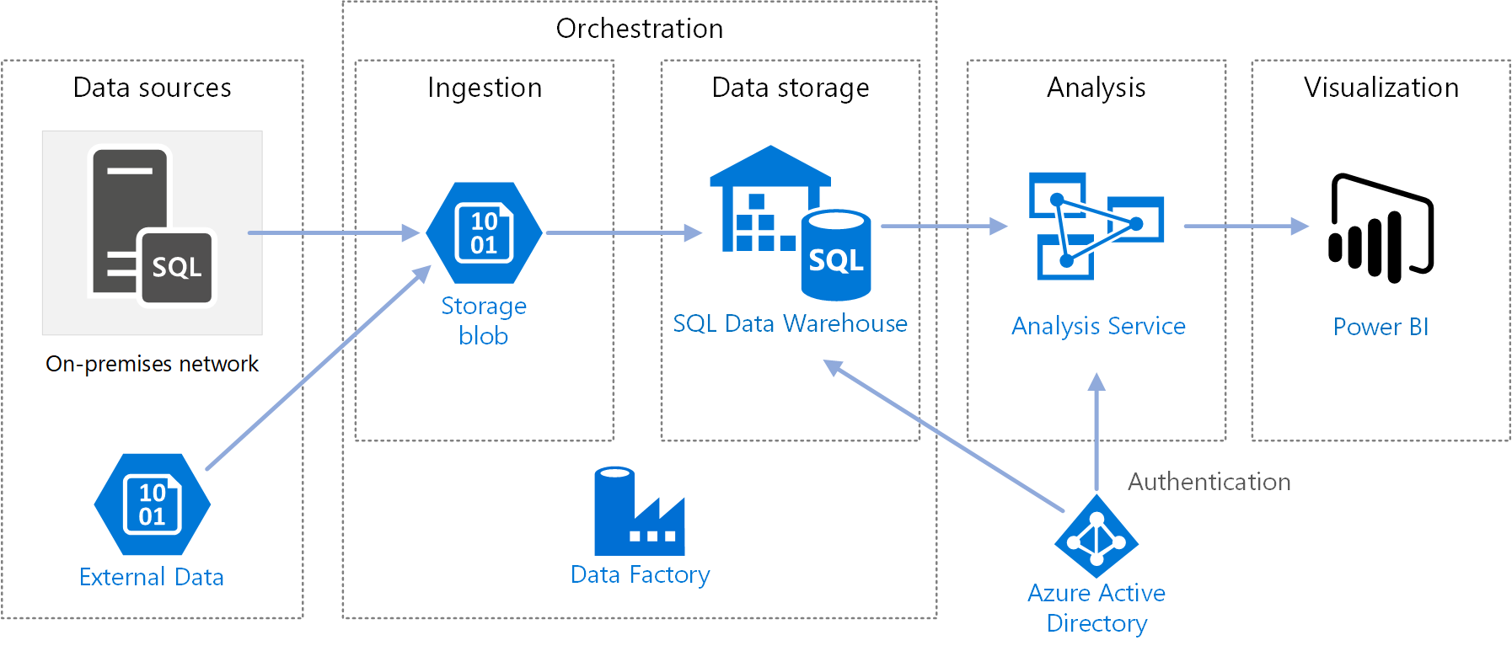
Azure Data Factory with SQL Data Warehouse

Slide 66
Demo
Loading data to Azure SQL Data Warehouse using Azure Data Factory
Loading 10 GB of data to Azure SQL Data Warehouse from Blob Storage using Azure Data Factory

Slide 67
Azure Storage

Slide 68
Azure Storage Account
A unique namespace to store and access your Azure Storage data objects
All objects in a storage account are billed together as a group
By default, the data in your account is available only to you, the account owner

Slide 69
Container
A container organizes a set of blobs, similar to a folder in a file system
All blobs reside within a container
A storage account can contain an unlimited number of containers, and a container can store an unlimited number of blobs

Slide 70
Blob
Azure Storage offers three types of blobs -- block blobs, append blobs, and page blobs
Page blobs:
Used to store virtual hard disks optimized for random read/write operations
Block blobs:
Used to store files like images and videos which are comprised of multiple blocks of data
Append blobs :
Typically used with text files or log files where you append a line item to the end of a file

Slide 71
Tiers
Hot storage tier
Optimized for storing data that is accessed frequently
Cool storage tier
Optimized for storing data that is infrequently accessed and stored for at least 30 days
Archive storage tier
Optimized for storing data that is rarely accessed and stored for at least 180 days

Slide 72
Why choose Azure Blob Storage?
Strong consistency
Object mutability
Multiple blob types
Easy-to-use geo-redundancy

Slide 73
Use cases
Serving images or documents directly to a browser
Storing files for distributed access
Streaming video and audio
Writing to log files
Storing data for backup and restore, disaster recovery, and archiving
Storing data for analysis by an on-premises or Azure-hosted service

Slide 74
Azure Blob Storage Account

Slide 75
Azure Blob Storage Account
BLOB storage is Binary Large Object
Storage for storing unstructured data
The data can be documents, images, videos, logs files, VM Disks (vhd)
URL to access blobs - https://accountname.blob.core.windows.net
Each BLOB can be of 100GB in size

Slide 76
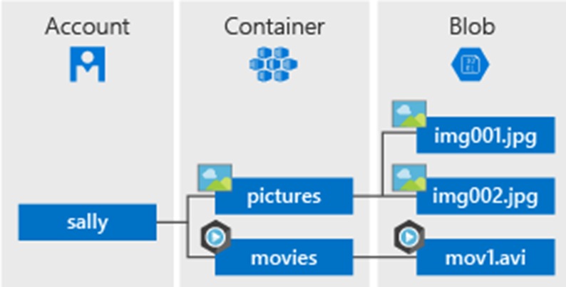
Blob Storage root level view

Slide 77
Demo
Deploying Azure Blob Storage Account to store Images
Migrating data to Azure Storage Account using AZCopy

Slide 78
Event Hubs

Slide 79
What is Event Hubs?
Big Data streaming platform & event ingestion service…

Slide 80
Event Hubs processing

Slide 81
Event Hubs real time use case?:
Anomaly detection
Application logging
Live dashboarding
Archiving data
Transaction processing

Slide 82
Pricing
 | BASIC | STANDARD | DEDICATED*
Ingress events | ₹1.86 per million events | ₹1.86 per million events | Included
Throughput unit (1 Mb/s ingress, 2 Mb/s egress) | ₹1.00/hour | ₹1.99/hour | Included
Message size | 256 KB | 256 KB | 1 MB
Consumer groups | 1 – Default | 20 | 20
Message replay | Available | Available | Available
Maximum throughput units | 20 | 20** | 1 CU≈50
Apache Kafka | Not available | Available | Available
Brokered connections | 100 included | 1,000 included | 25K included
Message retention | 1 day included | 1 day included*** | Up to 7 days included***
Additional brokered connections | Not available | Available | Available
Publisher policies | Not available | Available | Available
Capture | Not available | ₹6.61/hour | Included

Slide 83
Demo
Deploying Event Hub
Sending & receiving events using Event Hub
Use Kafka MirrorMaker with Event Hubs for Kafka

